Slide 1

A Short Course on QT
A cross-platform application framework
Download QT
http://www.qt.io/download/
by Napoleon Reyes, PhD

Slide 2
How to create a Simple QT Project
Widgets, global variables, etc.

Slide 3
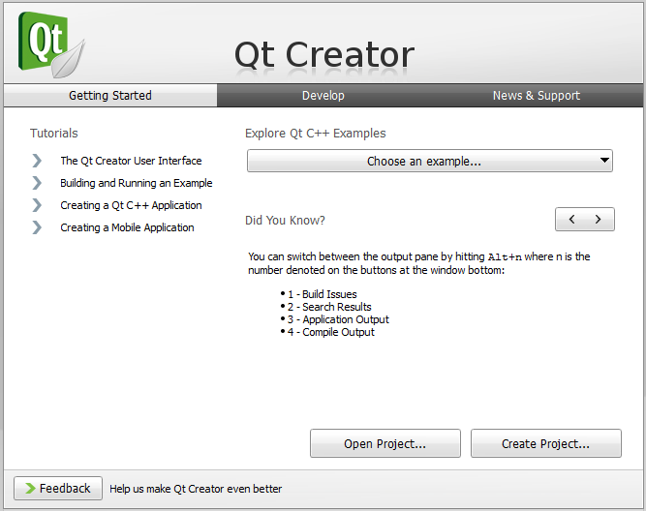
Project
Step 1
Create a Qt Project using the wizard.

Slide 4
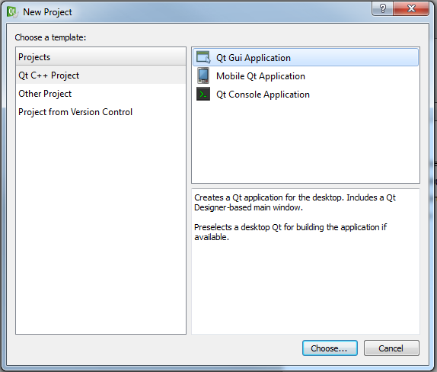
Project
Step 2
Select Qt Gui Application.

Slide 5
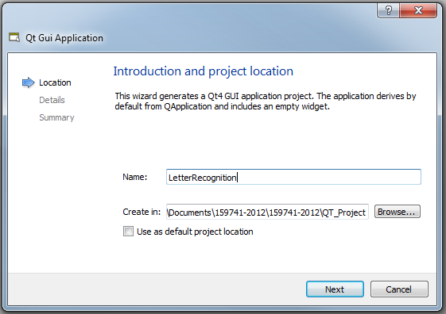
Project
Step 3
Create a new project.
Avoid using folder names with a space character (or any foreign characters).

Slide 6
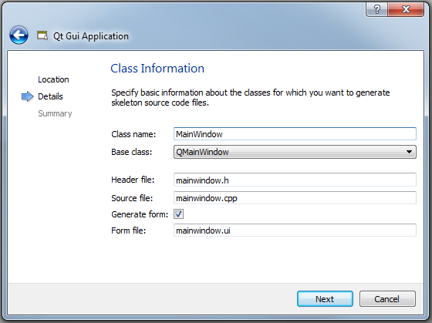
Project
Step 4
Use the default base class.

Slide 7
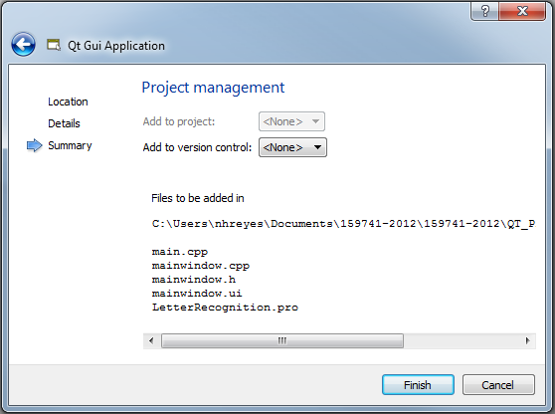
Project
Step 5
Files comprising the start-up codes.

Slide 8
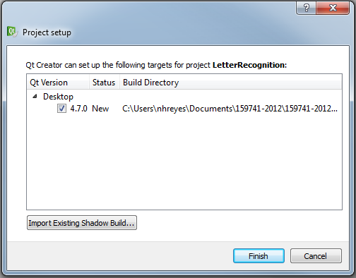
Project
Step 6
Use the default Build directory.

Slide 9
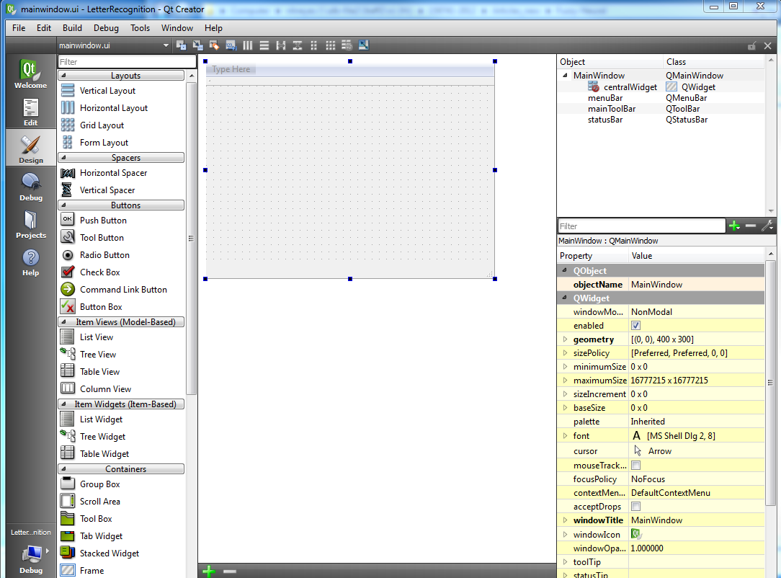
Project
Step 7
Design view

Slide 10
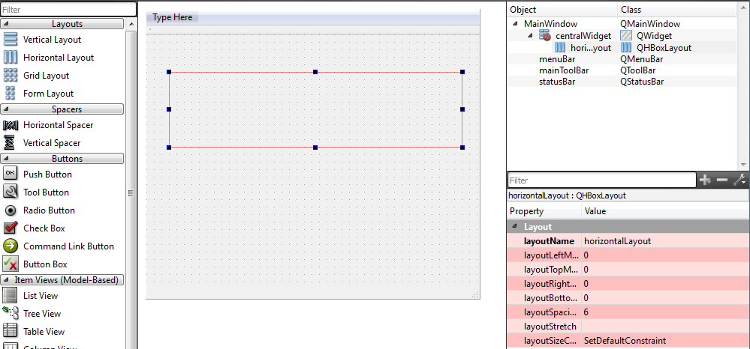
Project
Step 8
Add a horizontal layout

Slide 11
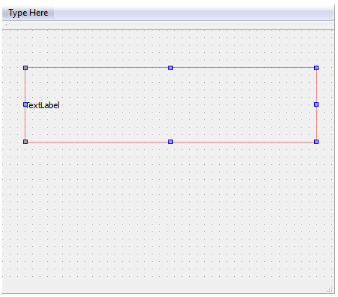

Project
Step 9
Add a label

Slide 12
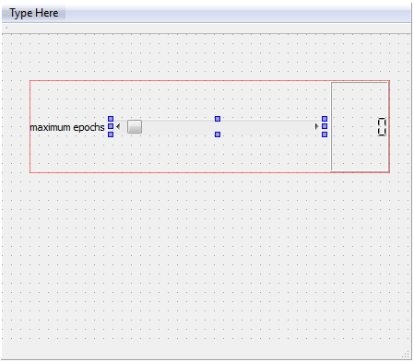

Project
Step 10
Add a horizontal scrollbar and an LCD number.
Widgets
Property value
horizontalScrollBar_maxEpochs
lcdNumber_maxEpochs

Slide 13
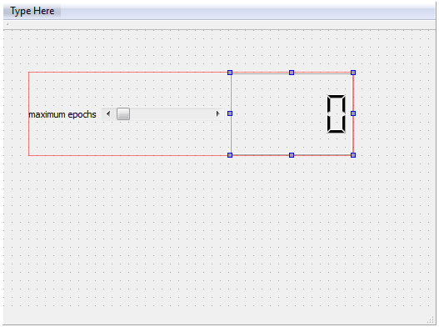

Project
Step 11
Add a horizontal scrollbar and an LCD number.
Widgets
Property value
horizontalScrollBar_maxEpochs
lcdNumber_maxEpochs

Slide 14
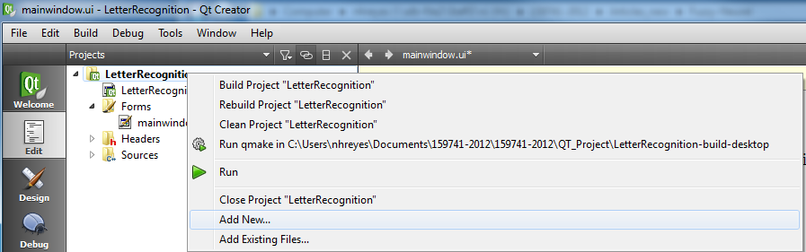
Project
Step 12
Switch to Edit mode, then add a header file to the project.

Slide 15
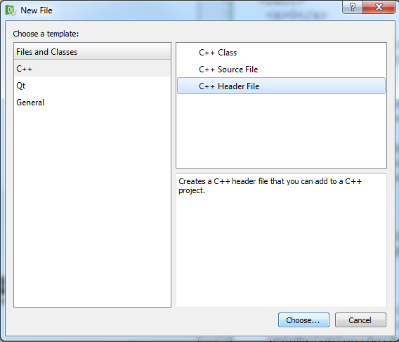
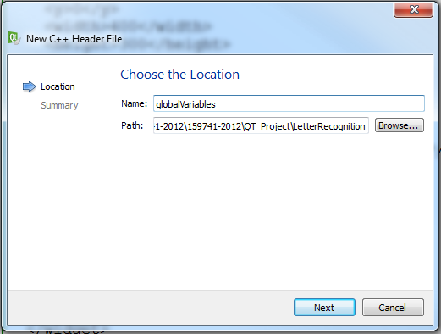
Project
Step 13
Switch to Edit mode, then add a header file to the project.
Click next, then finish.

Slide 16
Project
Step 14
Switch to globalVariables.h, then add an external variable declaration.
#ifndef GLOBALVARIABLES_H
#define GLOBALVARIABLES_H
extern int maxEpochs;
#endif // GLOBALVARIABLES_H

Slide 17
Project
Step 15
Switch to Design view by clicking main.cpp
#include <QtGui/QApplication>
#include "mainwindow.h"
int maxEpochs;
int main(int argc, char *argv[])
{
QApplication a(argc, argv);
MainWindow w;
w.show();
return a.exec();
}

Slide 18
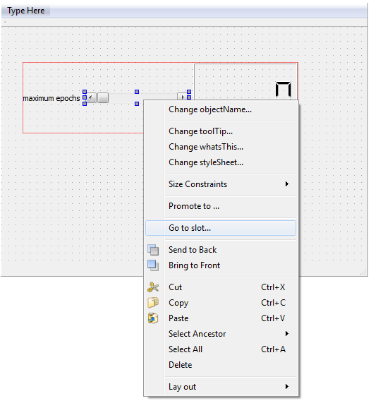
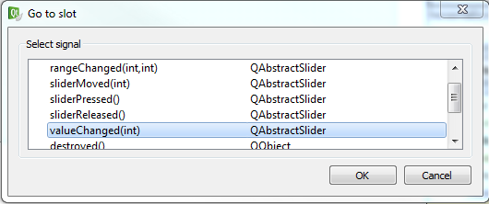
Project
Step 16
Associate a function with the horizontal scrollbar by right-clicking it, then selecting Go to slot, then the valueChanged() function.

Slide 19
Project
Step 17
Write the implementation for the valueChanged() signal.
#include "mainwindow.h"
#include "ui_mainwindow.h"
////////////////////////////////////////
#include "globalVariables.h“
MainWindow::MainWindow(QWidget *parent) :
QMainWindow(parent),
ui(new Ui::MainWindow)
{
ui->setupUi(this);
}
MainWindow::~MainWindow()
{
delete ui;
}
void MainWindow::on_horizontalScrollBar_valueChanged(int value)
{
ui->lcdNumber_maxEpochs->setSegmentStyle(QLCDNumber::Filled);
ui->lcdNumber_maxEpochs->display(value);
maxEpochs = value;
}

Slide 20
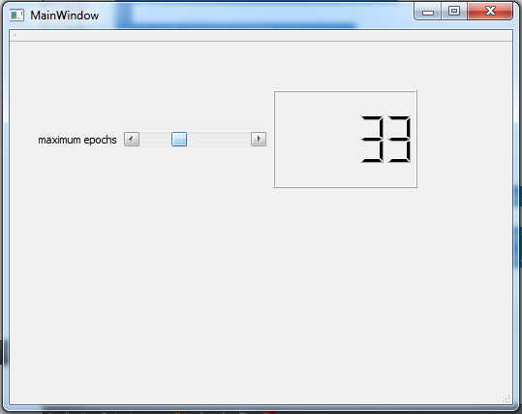
Project
Step 18
We now have an interface for the maxEpochs global variable.

Slide 21
Sample computations
How to utilise a widget value.

Slide 22
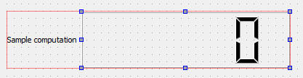
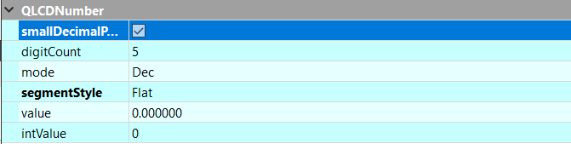
Project
Step 19
Add an LCD for displaying a calculated floating point value.
lcdNumber_result
Improves readability

Slide 23
Pushbutton

Slide 24
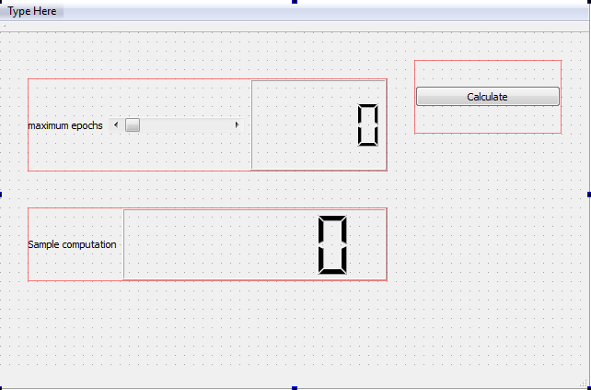
Project
Step 20
Add a pushButton.
pushButton_Calculate
Right-click the pushButton, then select Go to slot to assign a function to it’s clicked() signal.

Slide 25
Project
Step 20
Write the implementation for the clicked() signal, inside mainwindow.cpp.
void MainWindow::on_horizontalScrollBar_valueChanged(int value)
{
ui->lcdNumber_maxEpochs->setSegmentStyle(QLCDNumber::Filled);
ui->lcdNumber_maxEpochs->display(value);
maxEpochs = value;
}
void MainWindow::on_pushButton_Calculate_clicked()
{
qreal result=0.0;
result = maxEpochs * 2.2; //some hypothetical formula
ui->lcdNumber_result->display(result);
update();
QCoreApplication::processEvents();
}

Slide 26
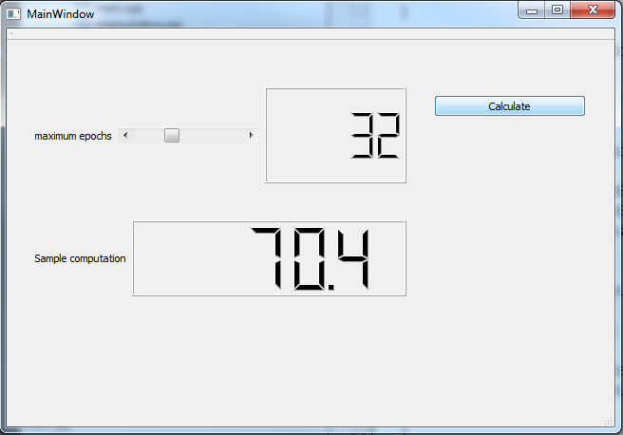
Project
Step 21
Sample run.
pushButton_Calculate

Slide 27
Project
Mouse cursor
How to change the mouse cursor to indicate busy calculation activity.
Add the following header first, in order to access the mouse cursor methods:
#include <QApplication>
QApplication::setOverrideCursor(QCursor(Qt::WaitCursor));
//perform lengthy operations here…
QApplication::restoreOverrideCursor();

Slide 28
Project
Widget’s display contents
How to update the gui’s display while running a loop?
By calling processEvents(), the display of the widget named ui->plainTextEdit_results will be updated for each iteration.
Example:
QString msg;
for(int i=1; i < trainingEpochs; i++){
msg.clear();
msg.append("Epoch = ");
msg.append(QString::number(i));
ui->plainTextEdit_results->setPlainText(msg);
QCoreApplication::processEvents(); // qApp->processEvents();
}

